Slide 1

Project Presentation :
Predictive Analysis Approach for Brain Stroke Prediction using various Machine Learning Algorithm
By:
Sampriti Ambale
Dinesh Kumar R
22-Aug-23

Slide 2
Life Cycle of Data Analytics:
DATA SCIENCE LIFECYCLE
01
Problem Statement
02
Data Mining
03
Data Cleaning
04
Data Exploration
05
Feature Engineering
06
Predictive Modeling

Slide 3
INDEX :
Problem Statement
Data Exploration
Data Visualization
Data EDA
Feature Engineering
Machine Learning Models
Conclusion
Problem Statement :
A stroke is a medical condition in which poor blood flow to the brain causes cell death.
The risk factor for stroke is hypertension, any of the heart diseases, tobacco smoking and average glucose level of person.
2 main Symptoms of stroke is bleeding and ischemia.
A Diagnosis is typically based on a physical exam and is supported by medical imaging such as a CT scan or MRI scan. A CT scan can rule out bleeding, but may not necessarily rule out ischemia, which early on typically does not show up on a CT scan. Other tests such as an electrocardiogram (ECG) and blood tests are done to determine risk factors and rule out other possible causes. Low blood sugar may cause similar symptoms.
With the followed analysis we are predicting the stroke percentage of person by considering these factored.
This will lead to preventing from stroke.
Problem Solving :
In this project, we attempt to bridge the gap by providing a systematic analysis of the various customer records for the purpose of stroke prediction.

Slide 4
Attribute Information :
ID : Patient ID
Gender : Sex of the patient [Male,Female]
Age : Age of patient
Hypertension : high blood pressure [1: Affected, 0:Not Affected]
heart_disease : Any of the heart disease [1: Affected, 0:Not Affected]
ever_married : Marital status [1: married, 2: not married]
work_type : Sector for a job patient is working[children, Govt_job, Never_worked, Private,Self-employed]
Residence_type : patient residing type [Urban,Rural]
avg_glucose_level : glucose level in blood of patient calculated in md (Milligrams per decilitre)
bmi : Body mass index (a persons weight in kilograms (or pounds) divided by the square of height in meters)
smoking_status : patient smoking status [formerly smoked,formerly smoked,formerly smoked,Unknown]
stroke : output value [1: stroke disease, 0: Normal]

Slide 5
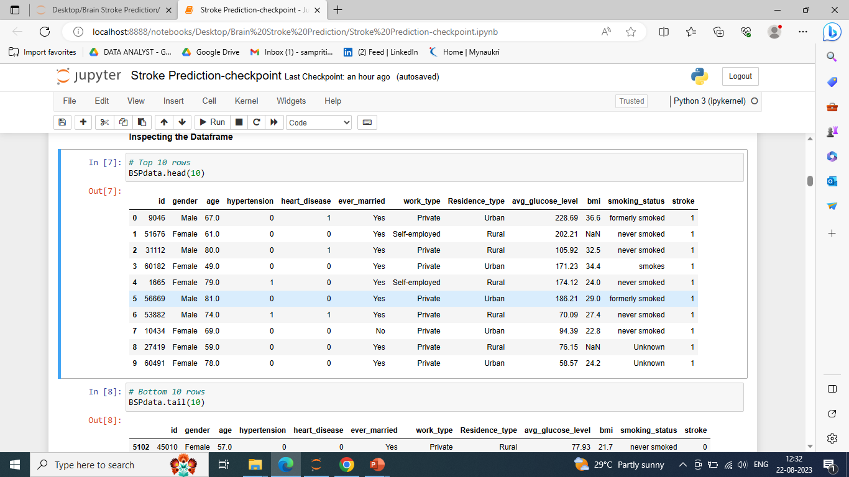
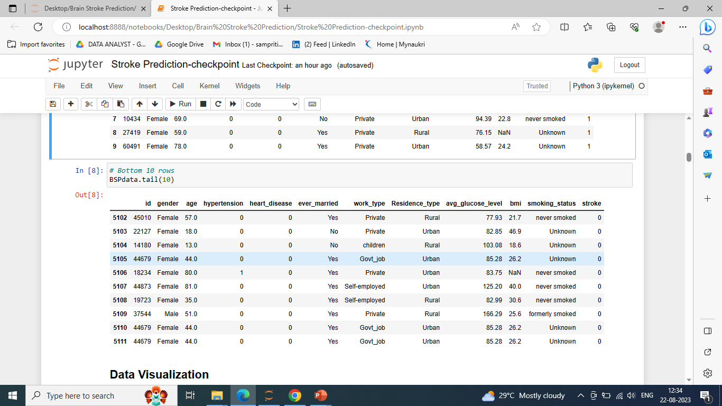
Data Exploration :
Data exploration is first step of data analysis used to explore and visualized data to uncover insights from the start or identify areas or pattern to dig into more.

Slide 6
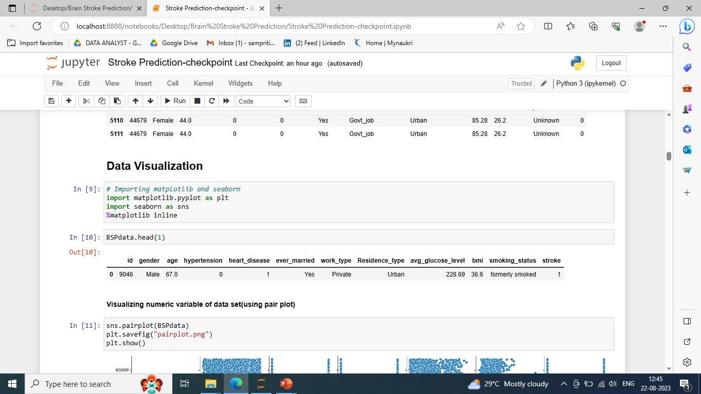
Data Visualization :
Data visualization is the graphical representation of information and data in a pictorial or graphical format Data visualization is the graphical representation of information and data in a pictorial or graphical format
Data visualization tools provide an accessible way to see and understand trends, patterns in data, and outliers.
For data visualization we used visualization ML library :-
Matplotlib
Seaborn

Slide 7
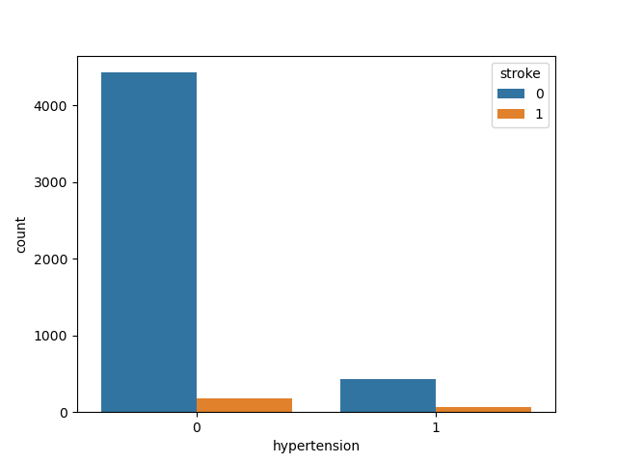
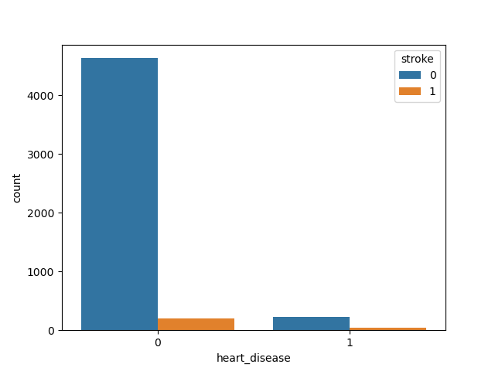
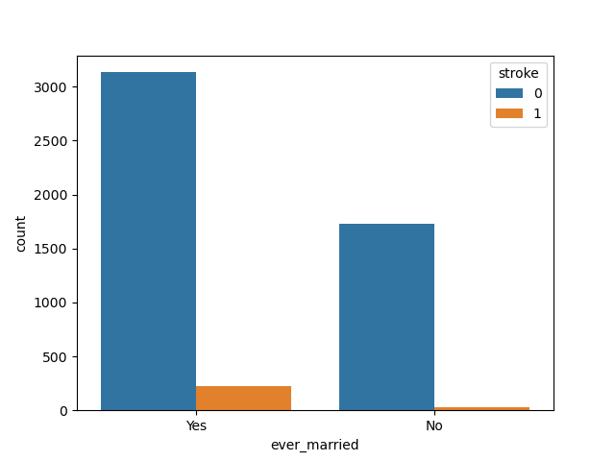
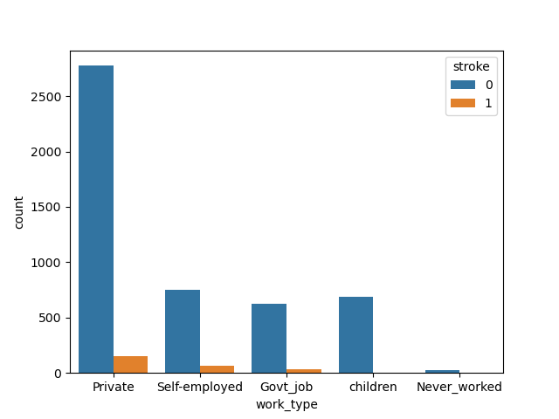
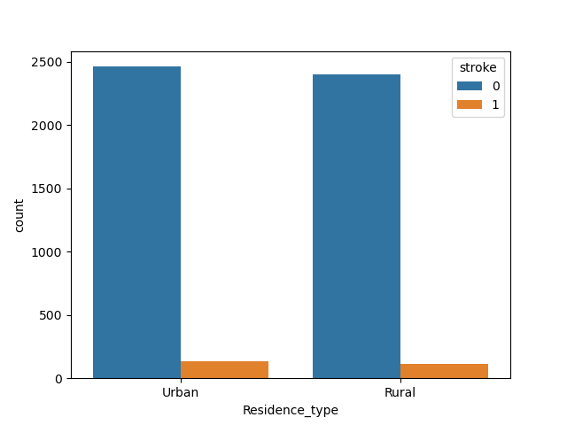
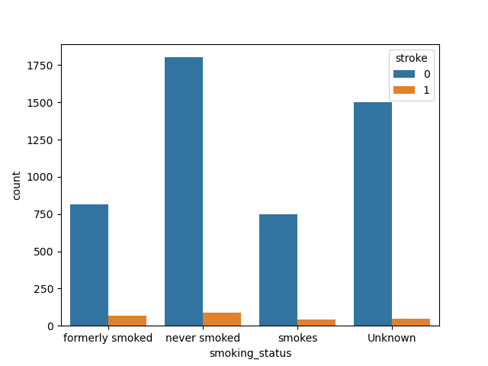
Categorical variable analysis = [hypertension, heart_disease, ever_married, work_type, Residence_type, smoking_status]
Insights :
Hypertension, heart_disease, ever_married, work_type, Residence_type and smoking_status are the Categorical variables of the data set.
Hypertension – less effectiveness towards stroke
Heart disease – few cases where marries person is observed with the stroke
Work type – as compared to other component private sector working person is bit effected to stroke
Residence type – component under this are almost equivalent to stroke

Slide 8
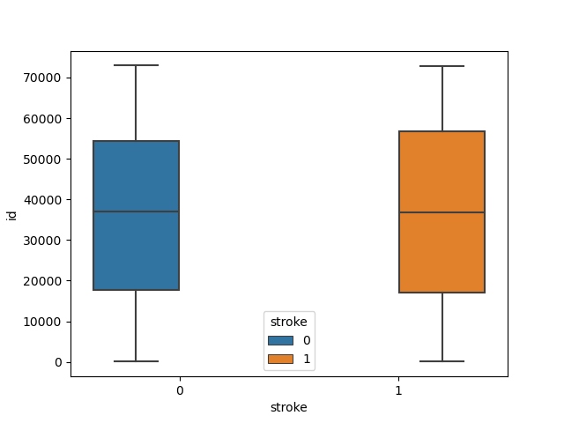
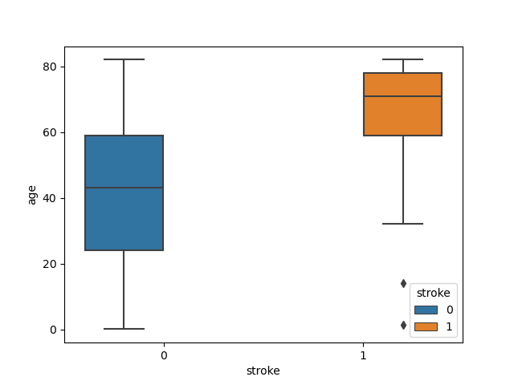
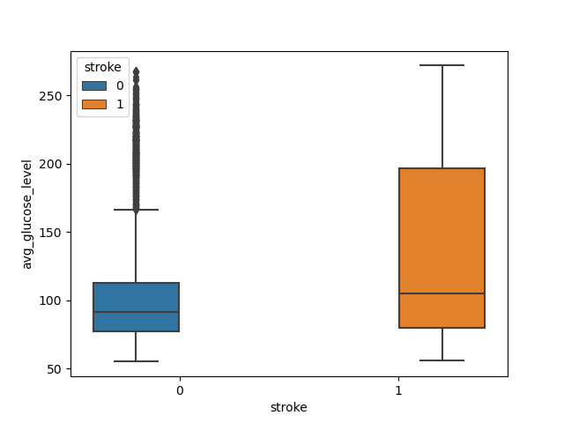
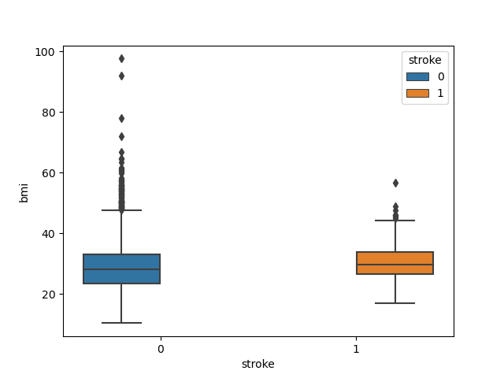
Contineous variable analysis = [id, age, avg_glucose_level, bmi]
Insights :
Id, age, avg_glucose_level, bmi are the Contineous variables of the data set.
Smoke is having equal contribution with stroke
>60 aged person more effected with stroke, 2 data points where age is <20 are also effected, but hypothetically it is justifiable
Glucose level from >50 and <200 are impacted towards stroke
BMI is sharing equal contribution towards stroke. Hypothetically is observed to be correct more than 60 range is also possible

Slide 9
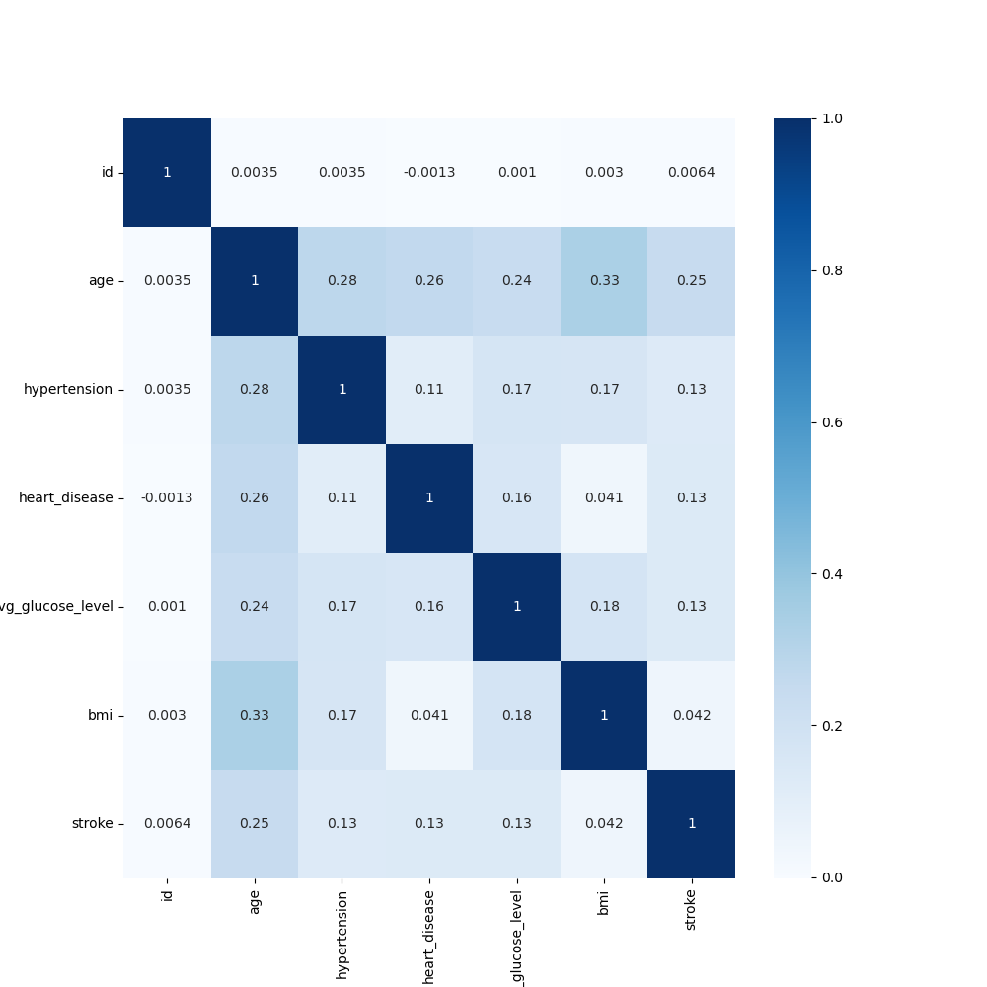
Corelation matrix with variables
It is very important to understand the correlation of every variable with respect to stroke
The darker the color, highly corelated to stroke
The lighter the color, less corelated to stroke
The Hypertension, highly corelated to stroke
The ID, less corelated to stroke

Slide 10
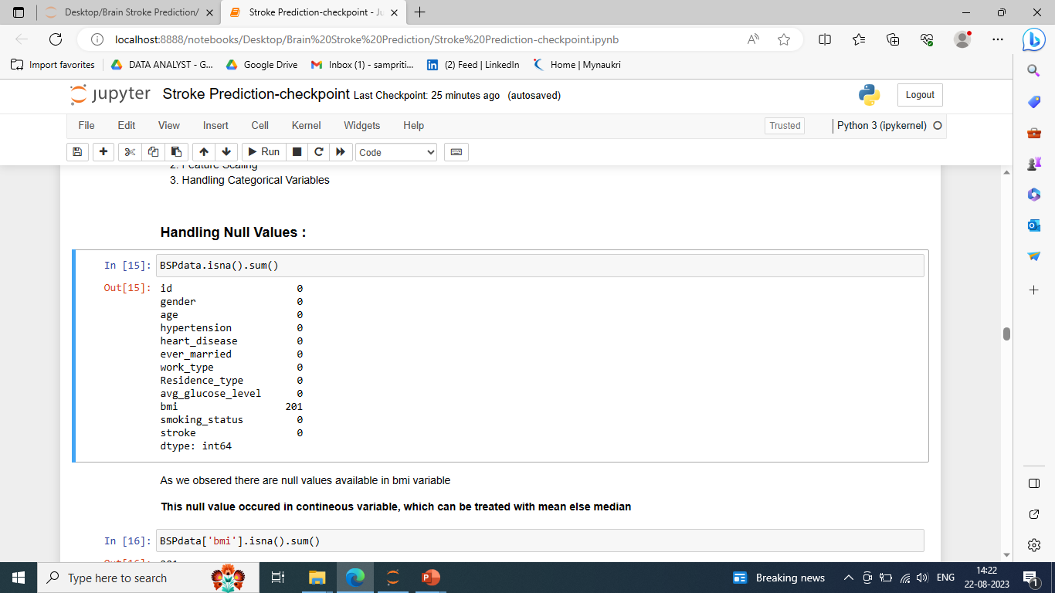
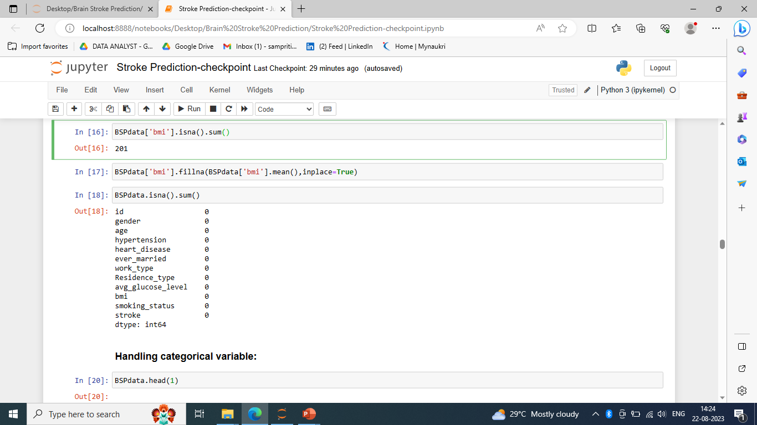
Exploratory Data Analysis:
In our data set there is no null value
201 null values are available in BMI column, which is continues. It can be treated with mean and mode

Slide 11
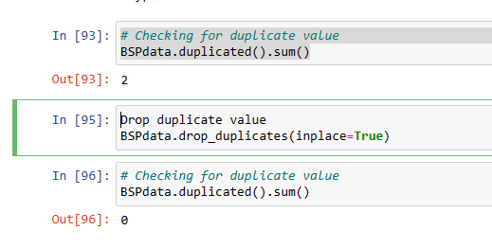
Exploratory Data Analysis:
In our data set there is no null value
Checking for duplicate values
201 null values are available in BMI column, which is continues. It can be treated with mean and mode
2 Duplicate values are available in data set
These are halalled with the deletion
BSPdata.duplicated().sum()
This Is used to check the duplicate values

Slide 12
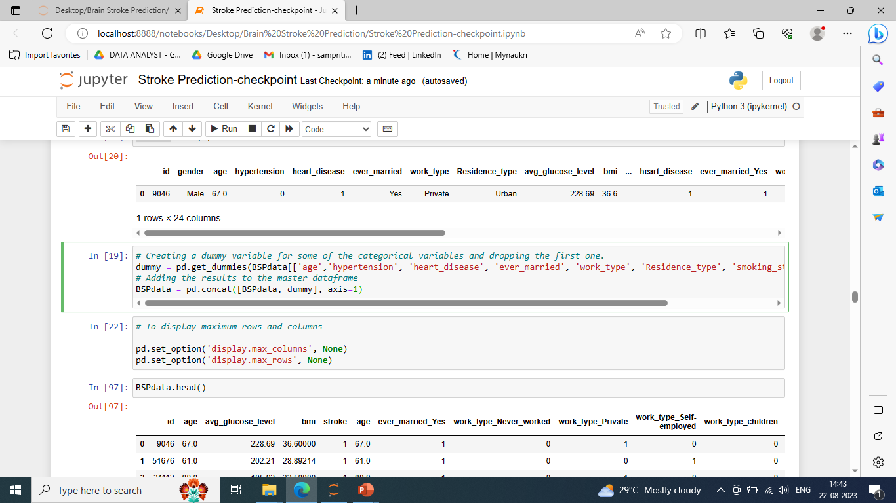
Feature Engineering: Label Encoding, One Hot Coding, Feature Scaling (Normalization)
Label Encoding : For Converting categorical variables into numerical format.
We do label encoding with these variables are as follows: -
(hypertension, heart_disease, ever_married, work_type, Residence_type, smoking_status)

Slide 13
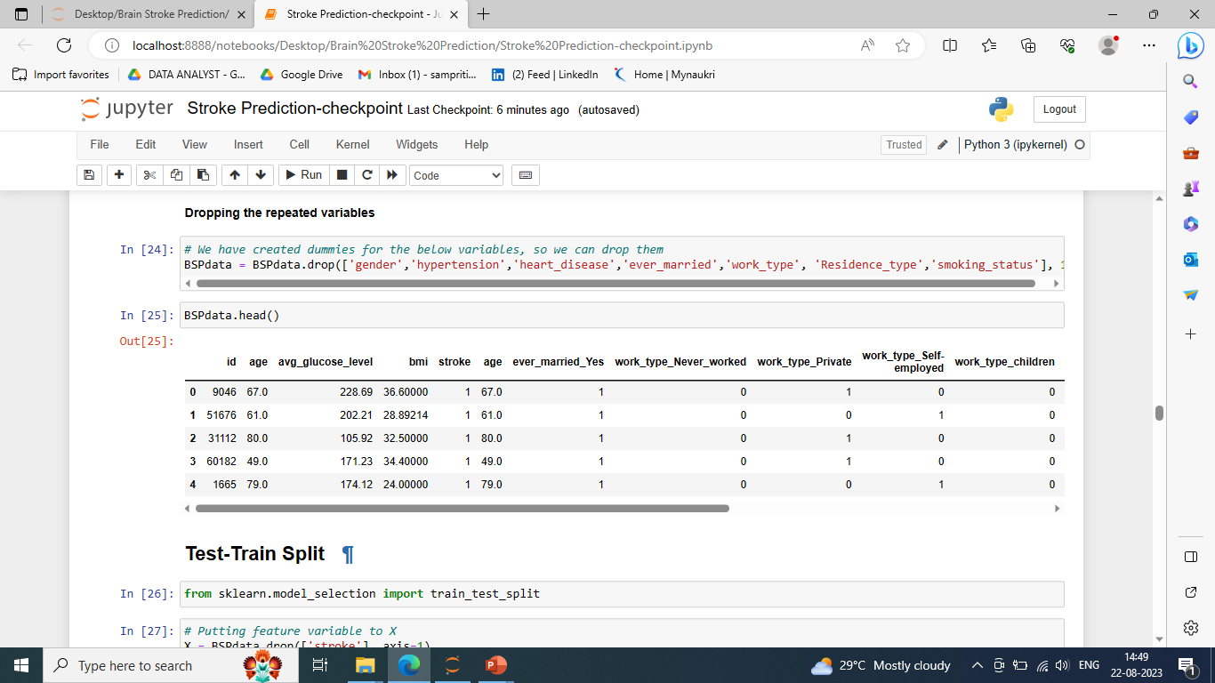
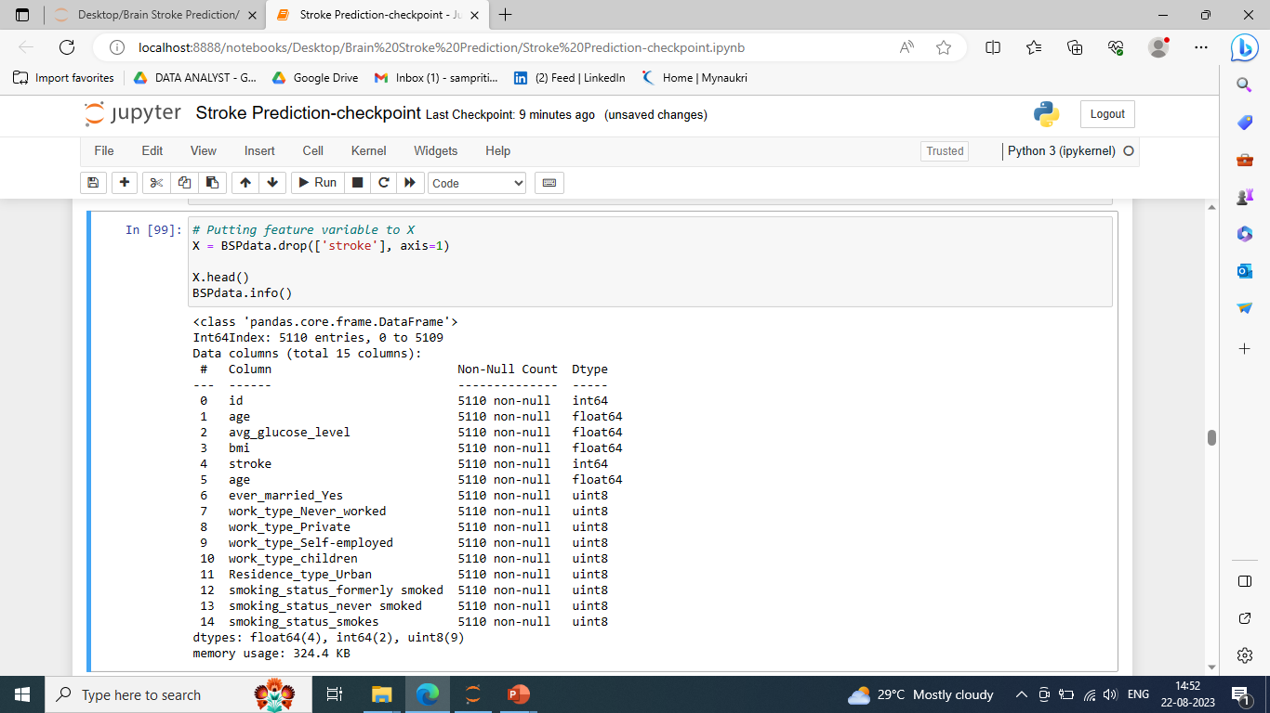
Feature Engineering: Label Encoding, One Hot Coding, Feature Scaling (Normalization)
One Hot Coding : For Converting categorical variables into numerical format.
After the label encoding & one hot coding over variable converted into the (int,float,unit8)
Here we are dropping the repeated values

Slide 14
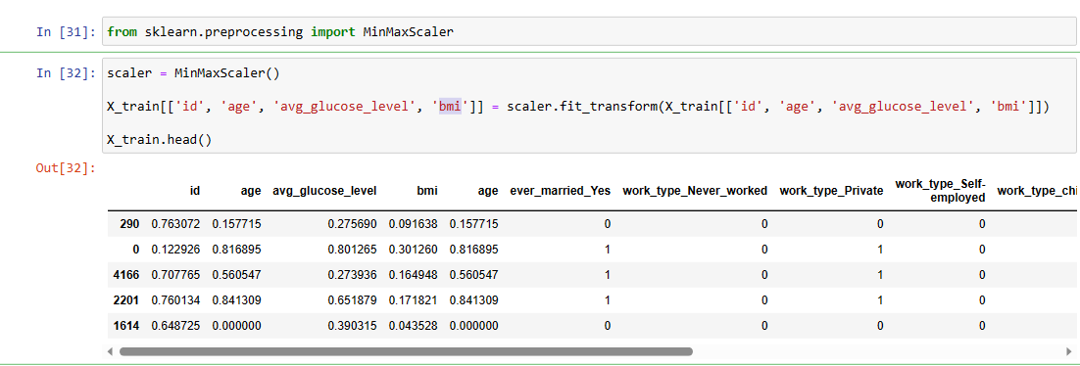
Feature Engineering: Label Encoding, One Hot Coding, Feature Scaling (Normalization)
Feature Scaling (Normalization) : Normalization is a scaling technique in which values are shifted and rescaled so that they end up ranging between 0 and 1
In below we are converted higher value into the range Between 0 and 1. for example id, age, avg_glucose_level and bmi

Slide 15
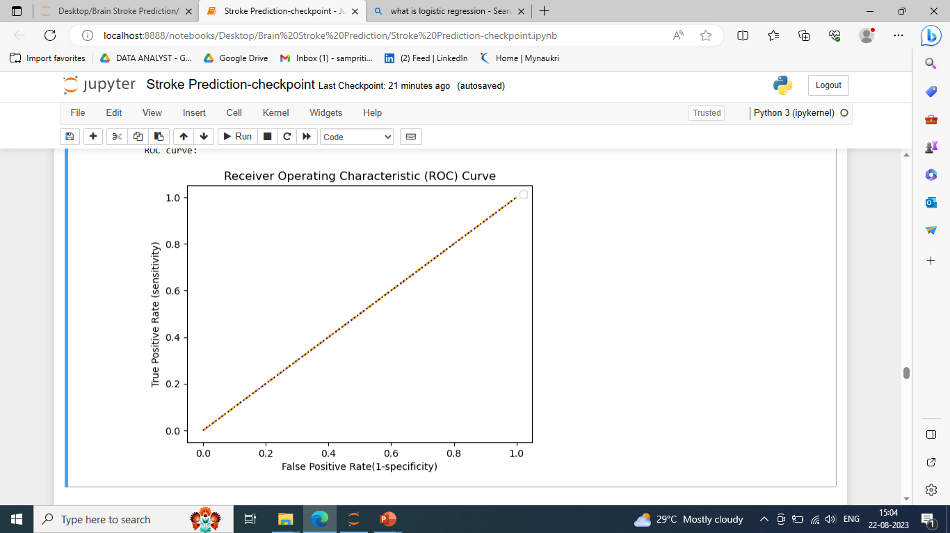
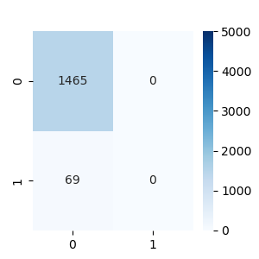
Model Building : Logistic Regression
Logistic Regression : Type of classification regression ,used for predicting the probability of a binary outcome
Library used : sklearn.linear_model (LogisticRegression)
Split used for training and testing the data : 70-30
Feature Scaling was performed after splitting the dataset to avoid information leakage on testing dataset by using Standardization method.
Accuracy : 95.5%
Recall :95%
Precision :100%

Slide 16
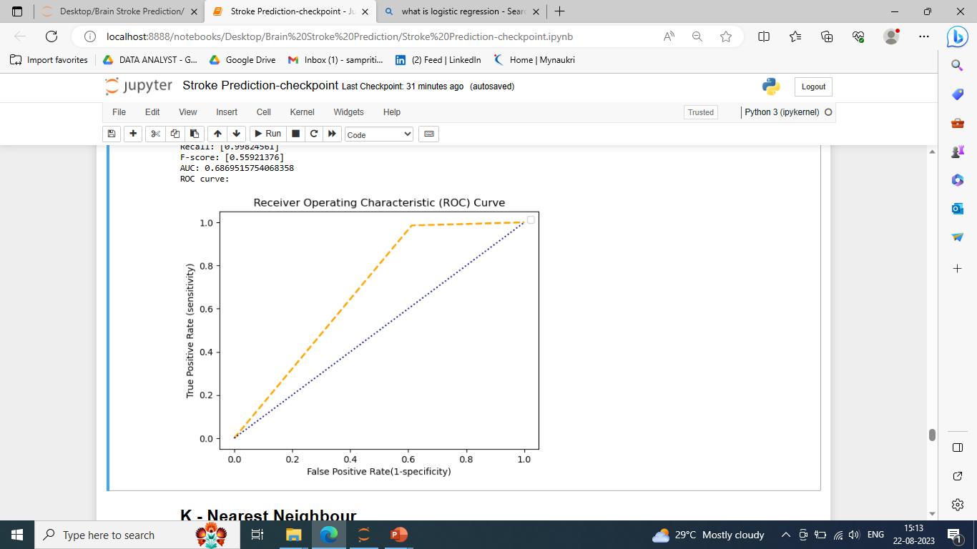
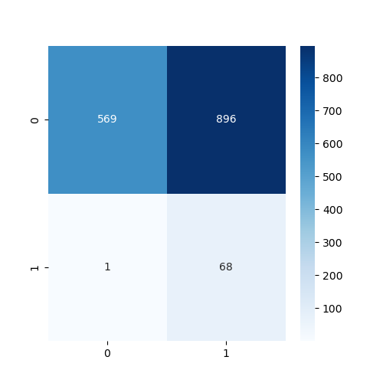
Model Building : Naive bayes Classification
Naive bayes Classification
Library used : sklearn.linear_model (Gaussian NB)
Split used for training and testing the data : 70-30
Accuracy : 45%
Recall : 99.8%
Precision : 38%

Slide 17
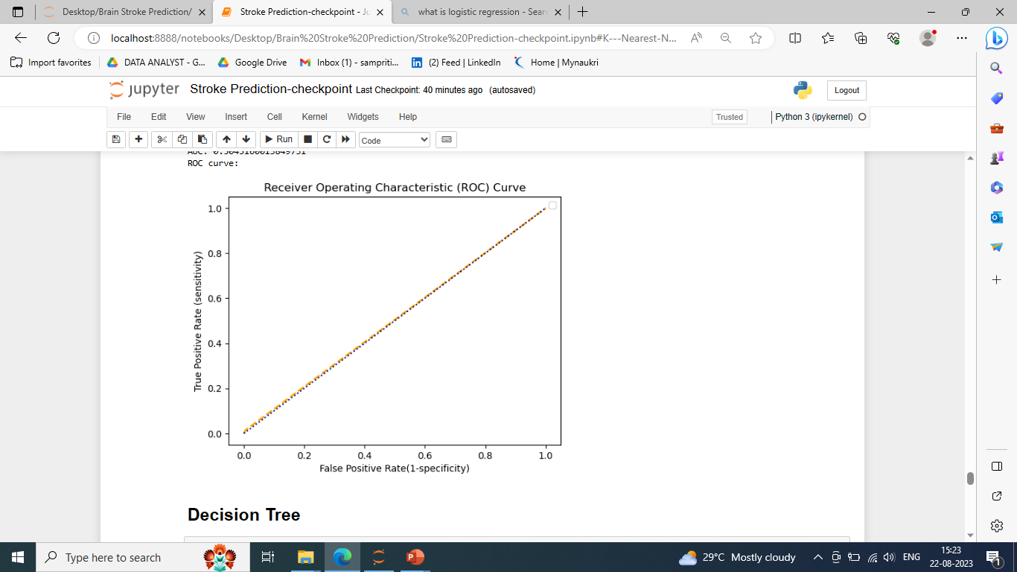
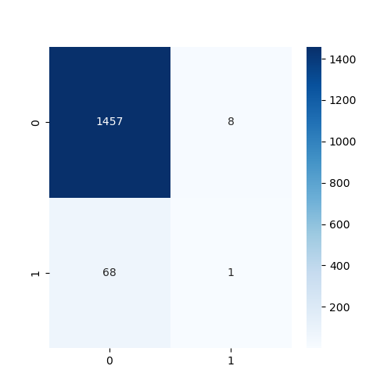
Model Building : K - Nearest Neighbor
K - Nearest Neighbor
Library used : sklearn.neighbors (Kneighbors Classifier)
Split used for training and testing the data : 70-30
Accuracy : 95%
Recall : 95%
Precision : 99%

Slide 18
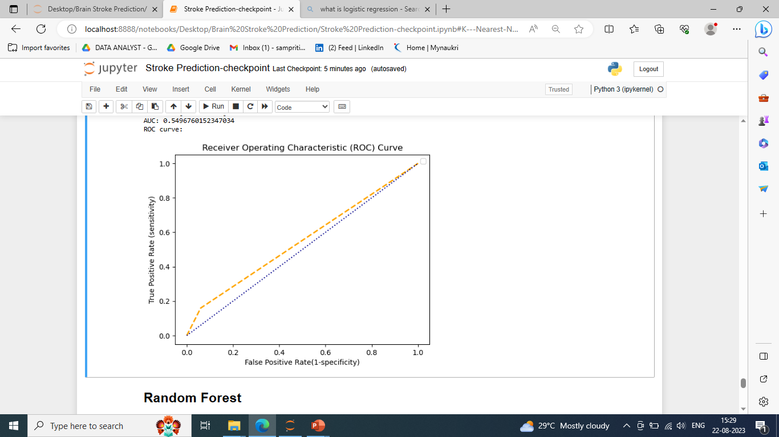

Model Building : Random Forest
Random Forest
Library used : sklearn.ensemble (RandomForestClassifier)
Split used for training and testing the data : 70-30
Feature Scaling was performed after splitting the dataset to avoid information leakage on testing dataset by using Standardization method.
Accuracy : 95.4%
Recall : 95%
Precision : 99%

Slide 19
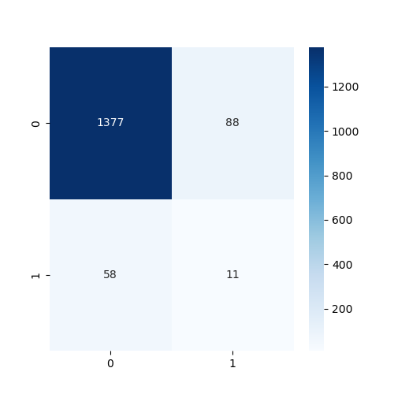
Model Building : Decision Tree
Random Forest
Library used : sklearn.tree (DecisionTreeClassifier)
Split used for training and testing the data : 70-30
Feature Scaling was performed after splitting the dataset to avoid information leakage on testing dataset by using Standardization method.
Accuracy : 90.4%
Recall : 95%
Precision : 93%

Slide 20

Model Building : Support Vector Machine (SVM)
Support Vector Machine
Library used : sklearn.tree (DecisionTreeClassifier)
Split used for training and testing the data : 70-30
Feature Scaling was performed after splitting the dataset to avoid information leakage on testing dataset by using Standardization method.
Accuracy : 95.5%
Recall : 95%
Precision : 100%

Slide 21
Accuracy score :
Support Vector Machine
Library used : sklearn.tree (DecisionTreeClassifier)
Split used for training and testing the data : 70-30
Feature Scaling was performed after splitting the dataset to avoid information leakage on testing dataset by using Standardization method.
Accuracy : 95.5%
Recall : 95%
Precision : 100%

Slide 22
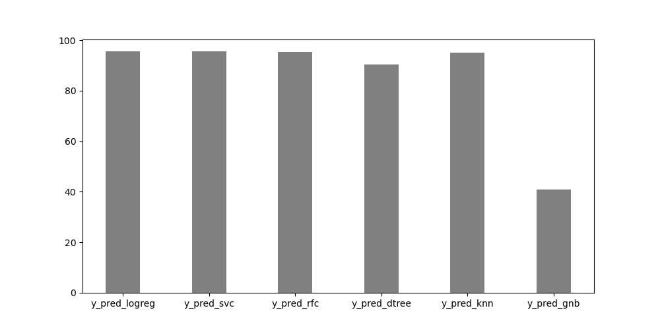
Accuracy score :
Summary on all algorithm
Logistic Regression is given

